Slide 1

HYpe4cast
TEAM LAST

Slide 2




THE team
Linda Ashih Saurabh Tim
4 computer engineers from Sweden, Germany and India | no finance background

Slide 3

We want to help you invest in the right stocks at the right time

Slide 4
WHAt we worked on
Hype4cast looks at social trends using data from Google Trends, tweets and hashtags, news outlets - and compares this data with stock market volumes in order to forecast stock volumes in the form of a newfound index named TVI (Trend-Volume-Index)
What is HOT right now?
Can trends influence the stock market?

Slide 5
How we are building this
Stock market volume
Google Trends
API
Based on trends &finance API
Google Finance API
Trend-Volume-Index
=
likelihood of a change in stock volume dependent on correlations between previous stock volumes and trends
Searches on popular topics
Trend Volume Index

Slide 6
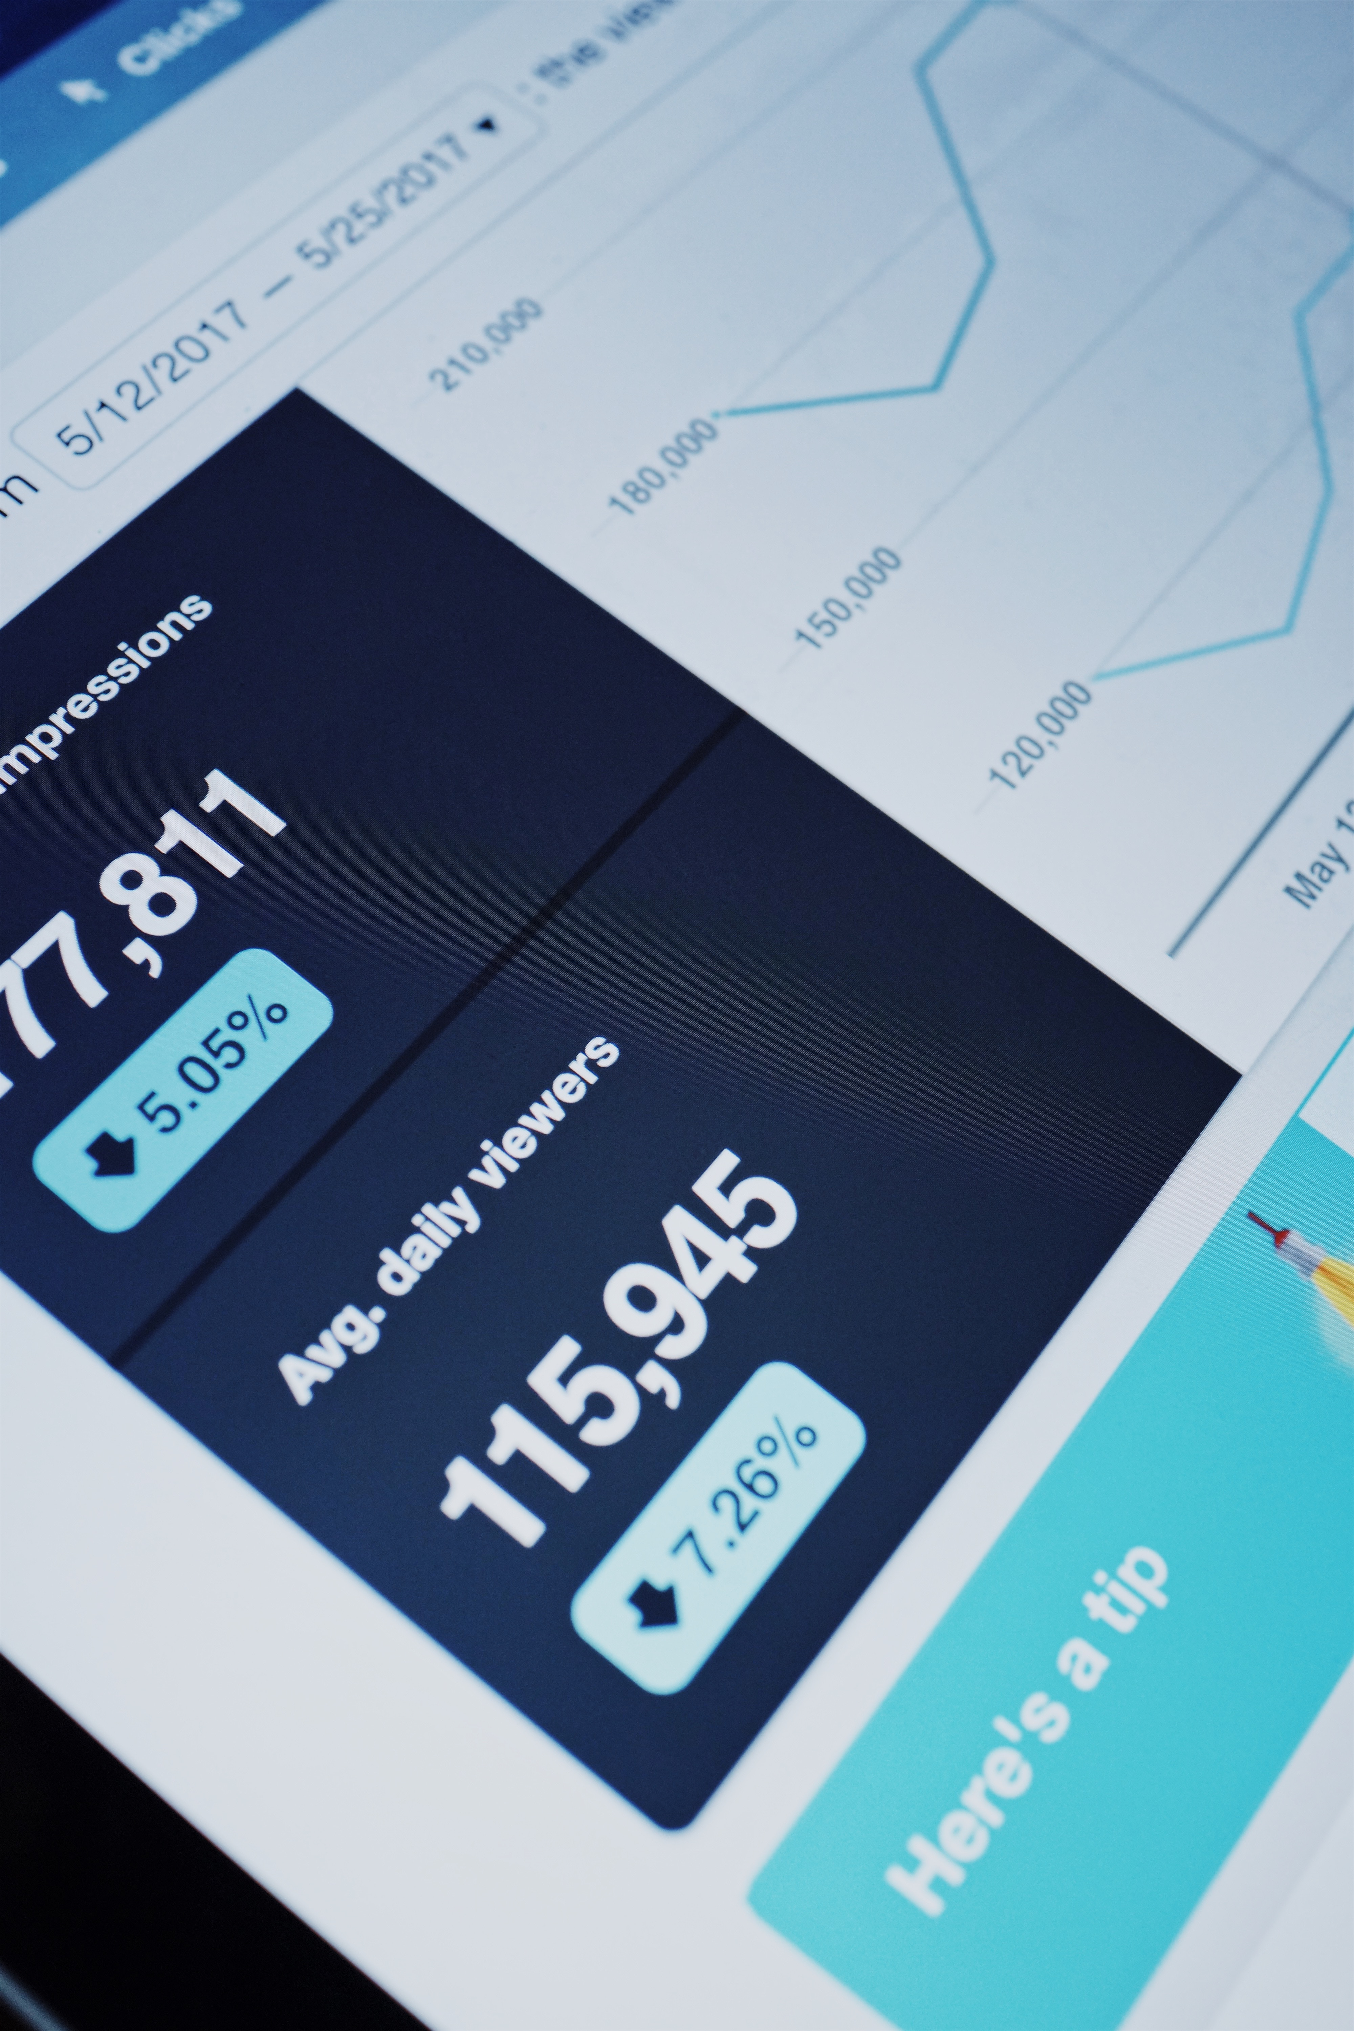
Technical Specification
We used Javascript APIs to extract information into JSON tables which we later import into Tableau software.
Tableau then creates beautiful graphs that you can use to make a decision.

Slide 7
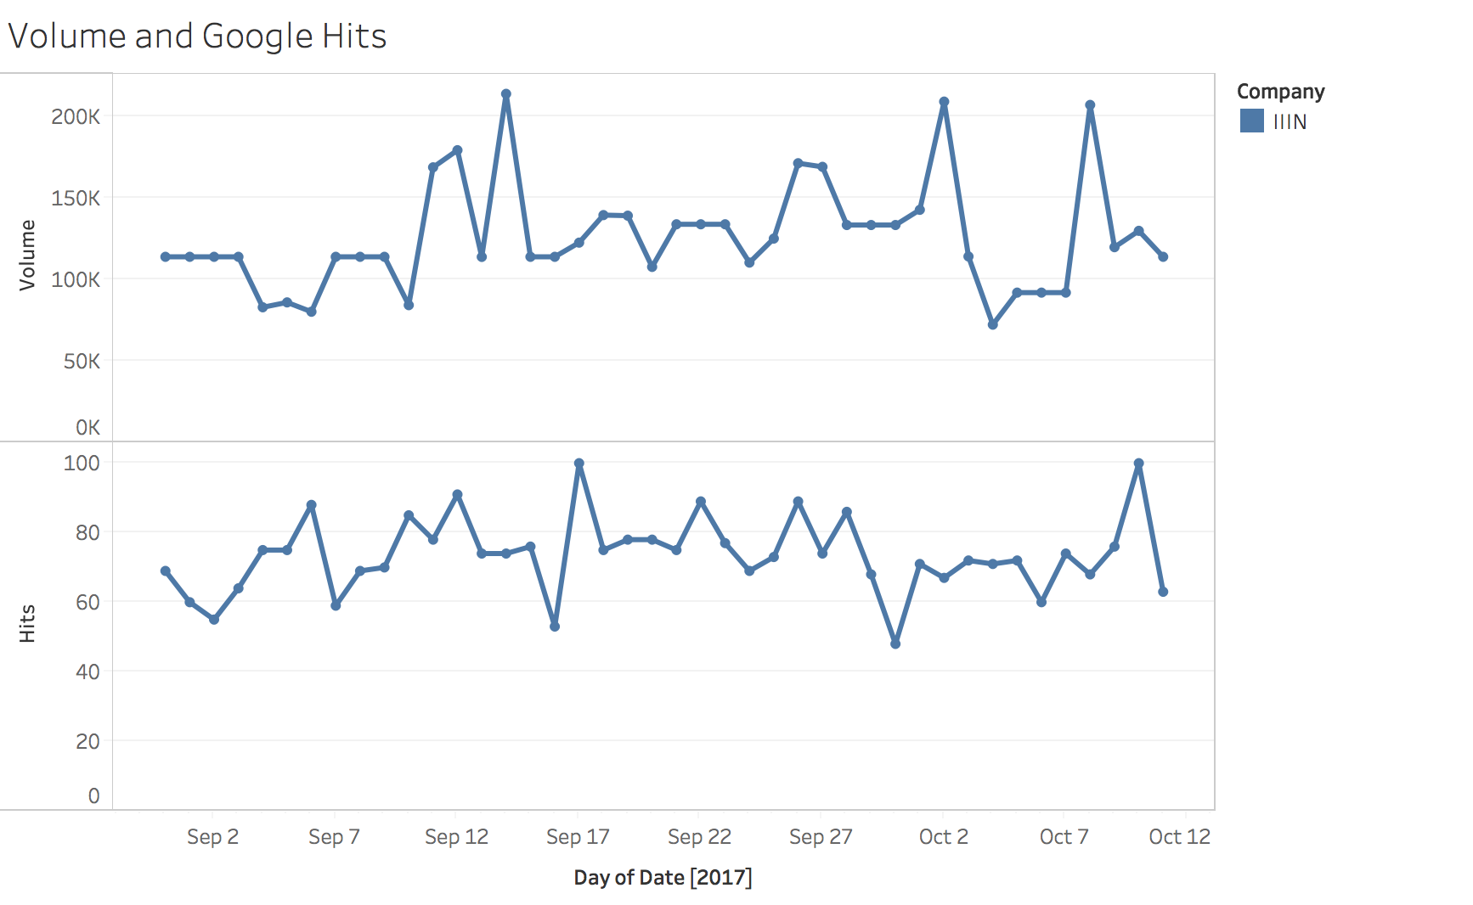
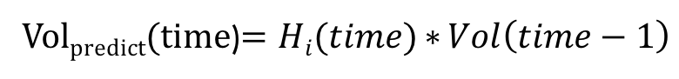
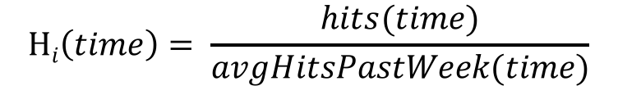
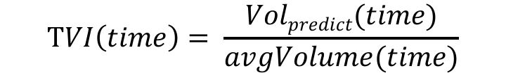
The Math
$$Hi\left(time\right)= \frac{hits(time)}{avgHitsPastWeek(time)}$$
$$TVI\left(time\right)= \frac{Volpredict(time)}{avgVolume(time)}$$
Vol_{predict}(time)$=Hi(time)∗{Vol\left(time−1\right)}$

Slide 8
You get real time information about hot trends
You know what will happen next on the market
YOUR BENEFITS
Use knowledge to invest in the right stock

Slide 9

What’s next for hype4cast
Notes:
Get a trend score based on tweets, hashtags, news sources as well

Slide 10

HYpe4cast
TEAM LAST

